Slide 1
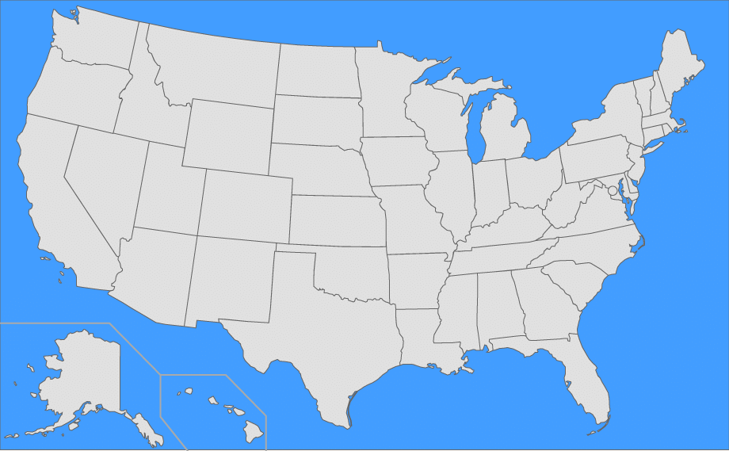

State of the Sun
Exploring Solar Photovoltaic Development Across US States
Group 2
Brian
Ethan
Shrey
Arne

Slide 2
What We’re Going to Talk About
Objective
Data sources
Coding approach
Data munging techniques
Final visualization
Notes:
May require more than one slide

Slide 3
Objective
Let the user explore the story of solar progress of solar photovoltaic (PV) system development in the US at the state level.
Look for answers to questions such as:
Which states are leaders and laggers in solar PV installation?
Does progress vary by system size, a typical indicator of PV system types?
Do state electricity costs appear to have a clear impact on PV installation levels?
For kicks: Do PV installations appear to correlate with the “dark side of the sun”?

Slide 4
Data Sources
Source | Data Elements | Data Type
National Renewable Energy Laboratory (NREL) Open PV Project | State total PV capacity installed State PV capacity installed by size Small (1-10 kW) Medium (10-100 kW) Large (100+ kW) | JSON or CSV
Energy Information Agency (EIA) | State average electricity cost | Web scrape
Center for Disease Control (CDC) | State skin cancer incidence rate | CSV
Reputable & consistent
Allow us to begin asking more detailed questions about the reasons for relationships we see
System size and what it tells us
Solar resource proxy
Data availability at the state level
Inconsistent availability of other state-level metrics of interest (e.g., solar resource, install cost)

Slide 5
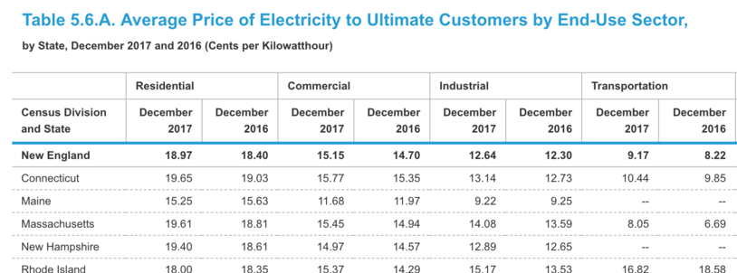
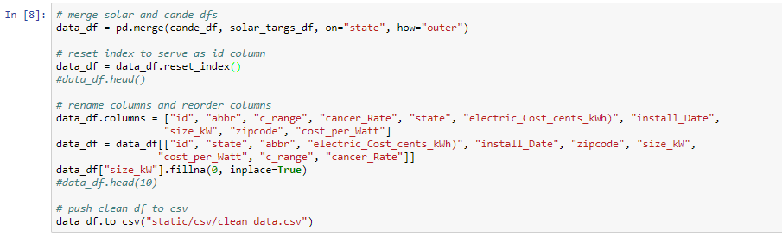
Coding Approach
Overall: Make use of relatively static data to simplify data acquisition & focus on visuals
CSV files and web scraping
Temporal scale of annual is appropriate
Easy to update by downloading new files
Data manipulation in Pandas
Notes:
EIA has data available

Slide 6
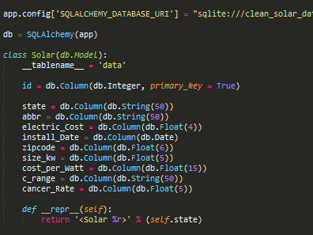
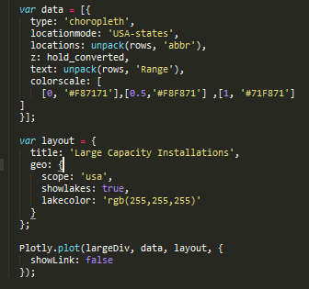
Coding Approach
SQLite Database w/ SQL Alchemy
HTML Templates
Per page
CSS styling
Notes:
EIA has data available

Slide 7
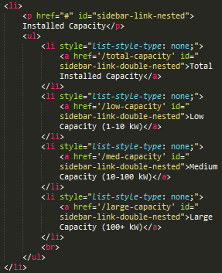
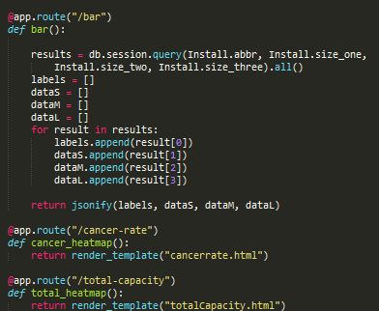
Coding Approach
HTML Templates
Bootstrap
CSS styling
JavaScript for interactive visuals
Plotly (shown)
D3
Navigation
Flask for app deployment
Separate routes per visual
(Seen w/ SQL Alchemy)
Notes:
EIA has data available

Slide 8
GO LOOK AT IT!
State of the Sun
(Why are you still here?)

Slide 9
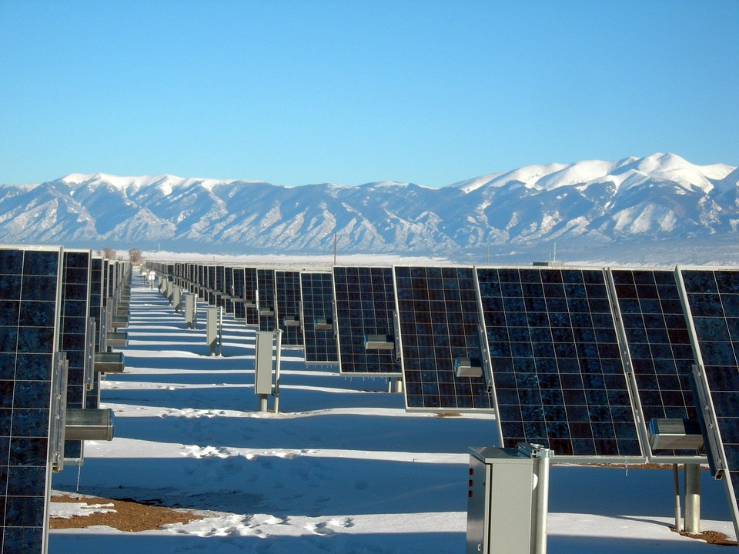
What would we do next?
Explore additional relationships
Installation by sector
State policies/programs
Proxies for solar resource
Visualize progress over time
Look for statistical correlations
Radial stacked bar chart
Looks like the sun!
Build a solar panel
Put on sunscreen
(Go to that place)

